Slide 1


WEEK 6
SPRINT 2
PL6
REQ

Slide 2


about us.

Slide 3
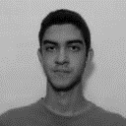
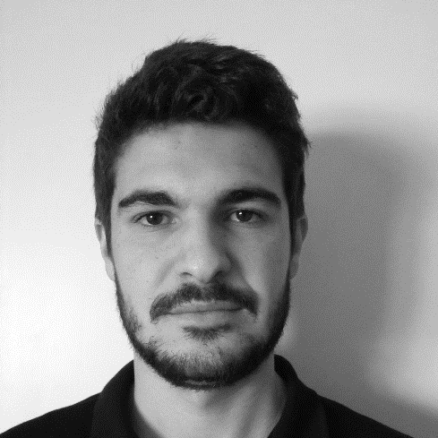
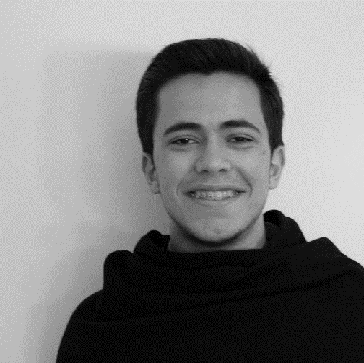
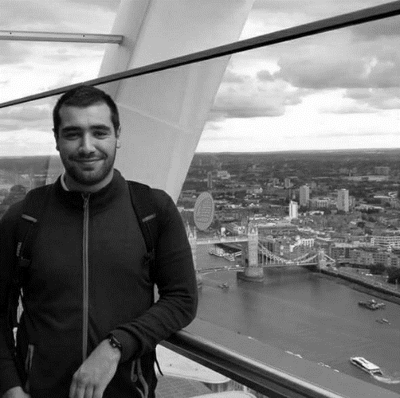
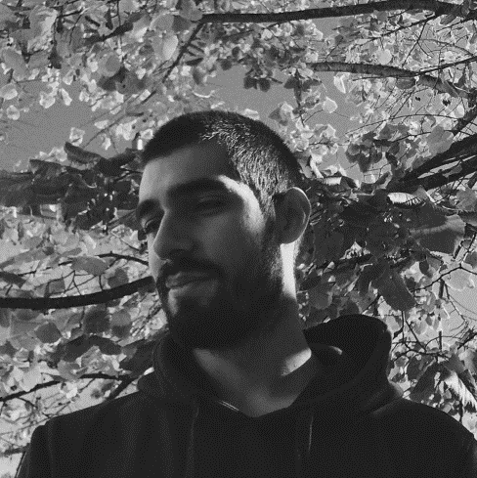
req.
Alexandre
Emanuel
Marco
Paulo
Nuno

Slide 4
tasks.
 | TASK #1 | TASK #2
TASK | Finish Mockups | Finish requirements document
OWNER | Nuno | Emanuiel, Marco , Paulo
GOAL EFFORT | 2 H | 4 H
STATUS | COMPLETED | COMPLETED

Slide 5
planned tasks.
 | TASK #1 | TASK #2
TASK | Update the REQ section of the quality manual | Perform a formal inspection on the whole Requirements document
OWNER | Emanuel, Nuno, Marco | Emanuiel, Marco , Paulo
GOAL EFFORT | 4 H 30 | 6 H
STATUS | NEW | NEW

Slide 6
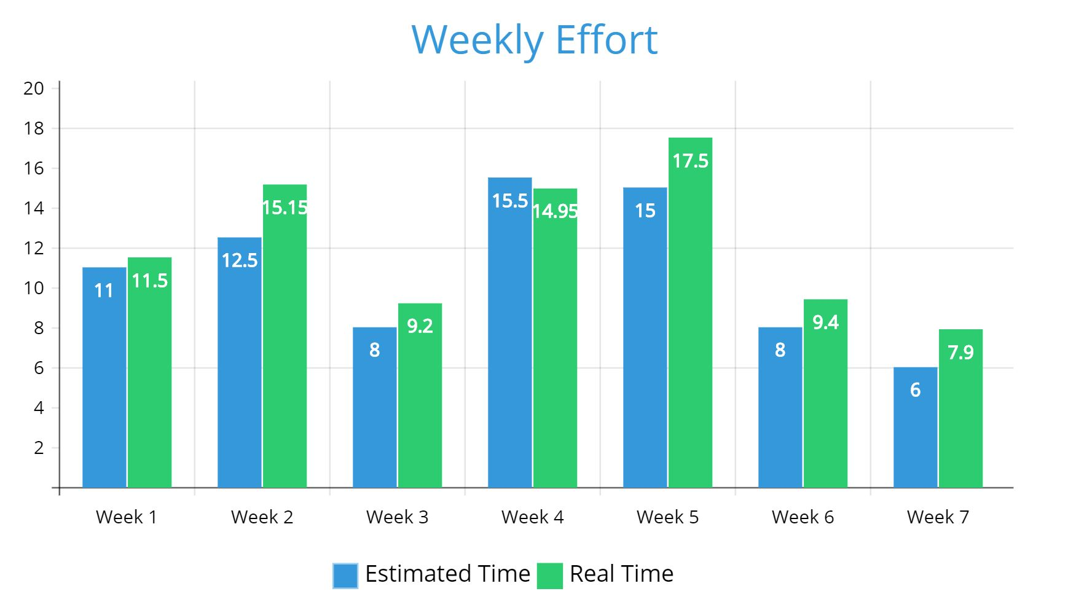
Weekly Effort

